Slide 1
Kafka
Lecturer: Ngo Huy Bien
Software Engineering Department
Faculty of Information Technology
VNUHCM - University of Science
Ho Chi Minh City, Vietnam
nhbien@fit.hcmus.edu.vn

Slide 2

Objectives

Slide 3

Contents

Slide 4

References

Slide 5
What is Kafka?
https://hub.docker.com/r/bitnami/kafka
Apache Kafka is a distributed streaming platform designed to build real-time pipelines and can be used as a message broker or as a replacement for a log aggregation solution for big data applications.

Slide 6
Kafka Features
https://kafka.apache.org/intro
To publish (write) and subscribe to (read) streams of events, including continuous import/export of your data from other systems.
To store streams of events durably and reliably for as long as you want.
To process streams of events as they occur or retrospectively.
And all this functionality is provided in a distributed, highly scalable, elastic, fault-tolerant, and secure manner.
Kafka can be deployed on bare-metal hardware, virtual machines, and containers, and on-premises as well as in the cloud.

Slide 7
Kafka Event
An event records the fact that "something happened" in the world or in your business.
It is also called record or message in the documentation.
Here's an example event:
Event key: "Alice"
Event value: "Made a payment of $200 to Bob"
Event timestamp: "Jun. 25, 2020 at 2:06 p.m."

Slide 8
Kafka Producer and Consumer
Producers are those client applications that publish (write) events to Kafka, and consumers are those that subscribe to (read and process) these events.

Slide 9
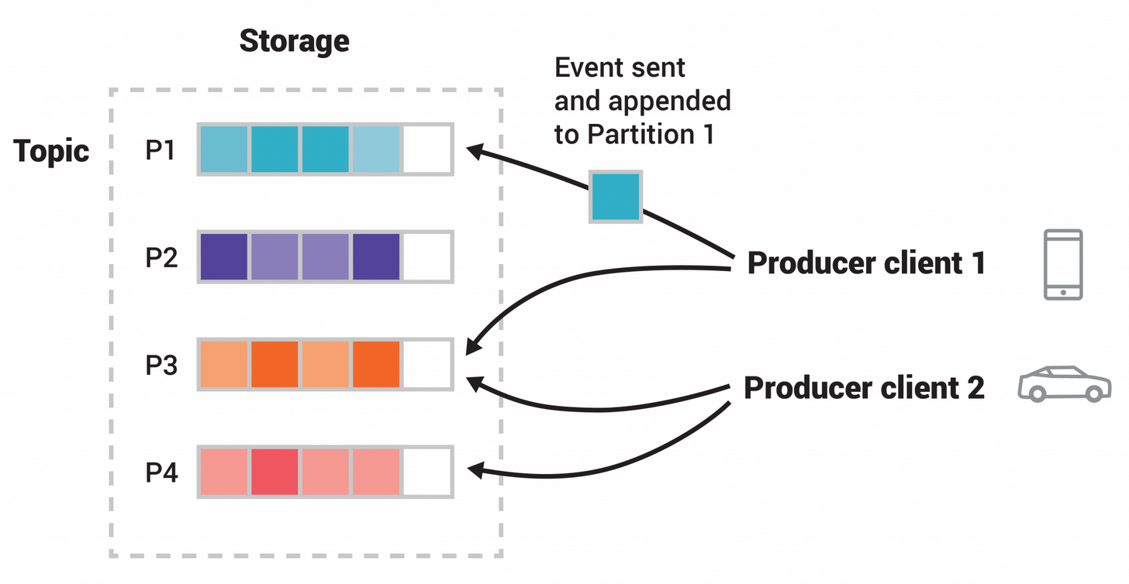
Kafka Topics
Events are organized and durably stored in topics.
Topics in Kafka are always multi-producer and multi-subscriber: a topic can have zero, one, or many producers that write events to it, as well as zero, one, or many consumers that subscribe to these events.
Topics are partitioned, meaning a topic is spread over a number of "buckets" located on different Kafka brokers.

Slide 10
1. Download and Run Kafka
https://kafka.apache.org/quickstart
https://kafka.apache.org/downloads
curl https://mirror.downloadvn.com/apache/kafka/2.8.0/kafka_2.13-2.8.0.tgz -o kafka_2.13-2.8.0.tgz
tar -xzf kafka_2.13-2.8.0.tgz
cd kafka_2.13-2.8.0
# Start the ZooKeeper service # Note: Soon, ZooKeeper will no longer be required by Apache Kafka.
bin/zookeeper-server-start.sh config/zookeeper.properties
# Start the Kafka broker service (in another terminal session)
bin/kafka-server-start.sh config/server.properties

Slide 11
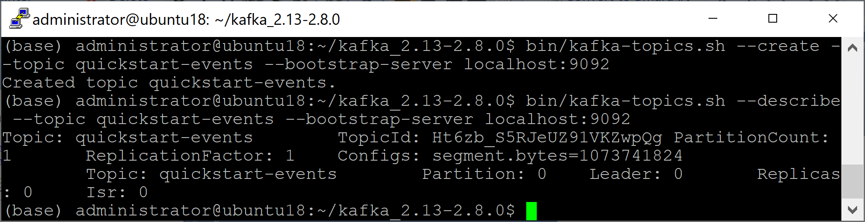
2. Create a Topic
bin/kafka-topics.sh --create --topic quickstart-events --bootstrap-server localhost:9092
bin/kafka-topics.sh --describe --topic quickstart-events --bootstrap-server localhost:9092

Slide 12
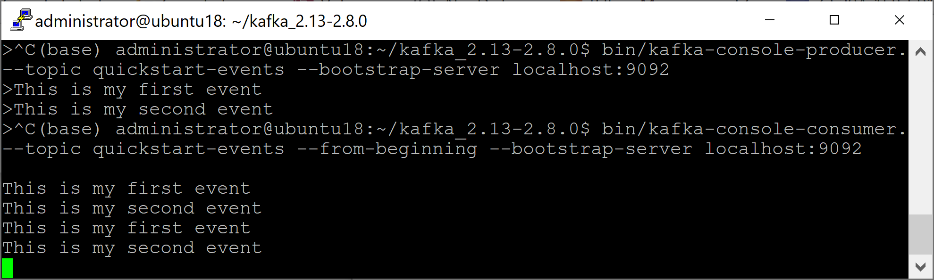
3. Write and Read Events
bin/kafka-console-producer.sh --topic quickstart-events --bootstrap-server localhost:9092
bin/kafka-console-consumer.sh --topic quickstart-events --from-beginning --bootstrap-server localhost:9092

Slide 13
Why Kafka?

Slide 14


Slide 15
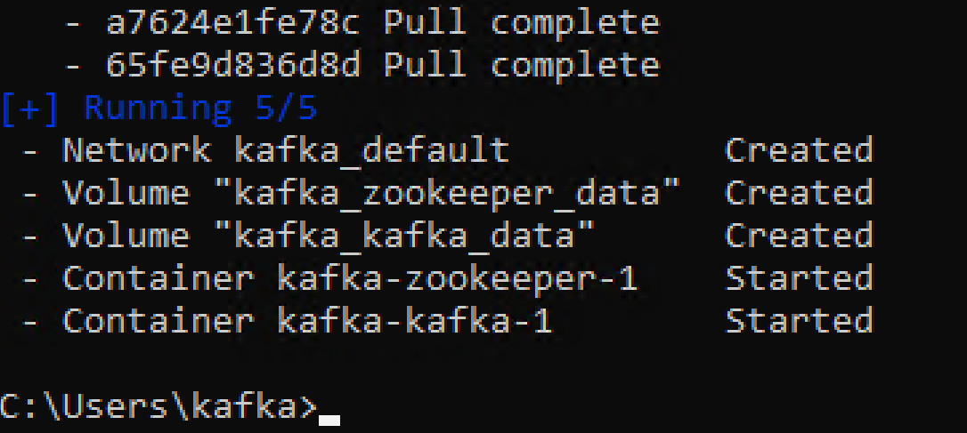
1. Run Kafka Docker Image
https://hub.docker.com/r/bitnami/kafka
mkdir kafka
cd kafka
curl -sSL https://raw.githubusercontent.com/bitnami/bitnami-docker-kafka/master/docker-compose.yml > docker-compose.yml
docker-compose up -d

Slide 16
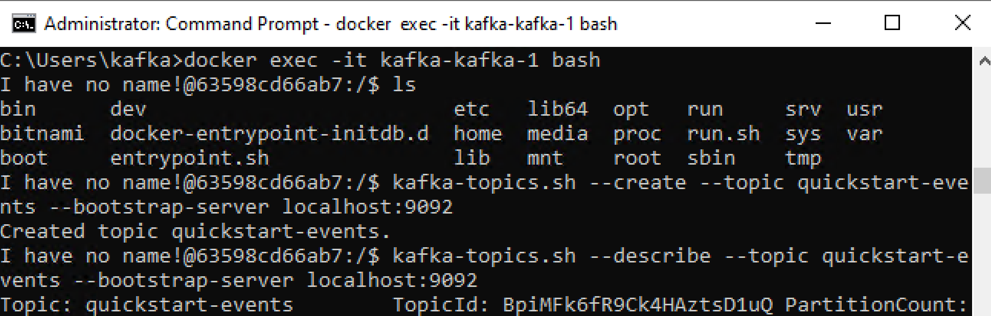
2. Connect to Kafka Container
docker exec -it kafka-zookeeper-1 bash
kafka-topics.sh --create --topic quickstart-events --bootstrap-server localhost:9092
kafka-topics.sh --describe --topic quickstart-events --bootstrap-server localhost:9092
This is my first event.
This is my second event.
kafka-console-producer.sh --topic quickstart-events --bootstrap-server localhost:9092

Slide 17

Further Reading
https://kafka.apache.org/books-and-papers

Slide 18

Thank You & See You Again

